Slide 1
Data Modelling & Statistical Analysis Hands on
Saravanan S
Data Science Research Scholar

Slide 2
Problem Statement
Predict the missing values of the following variables:
MashThickness
BoilGravity
PitchRate
PrimaryTemp
Statistical analysis of the data to derive model creation

Slide 3
Input Data Sample
Beer Sample
Beer Test
Beer Train

Slide 4
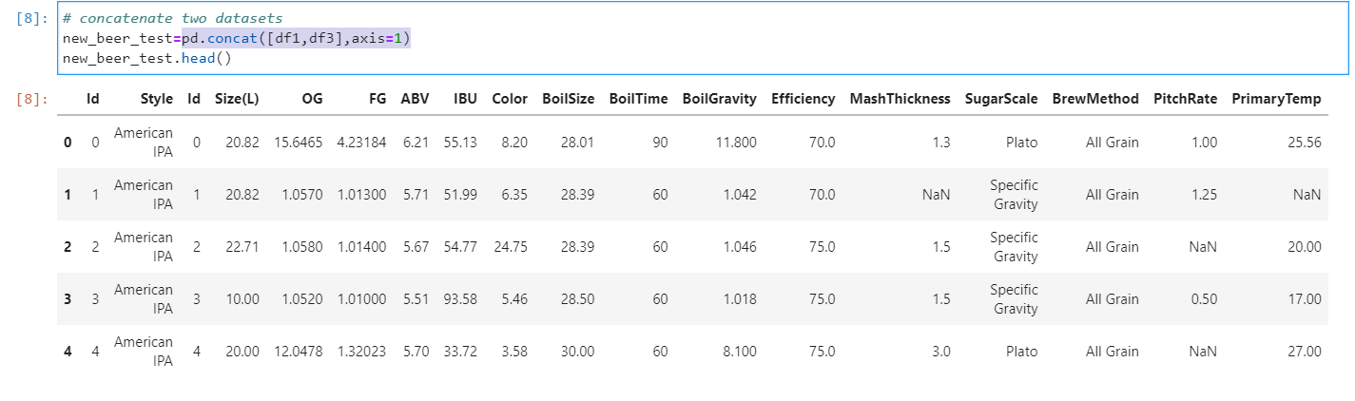
Merging of the Data Samples
To get style variable in beer_test we merge the two data set.
Two datasets are concatenated using pd.concat([df1,df3], axis=1)

Slide 5
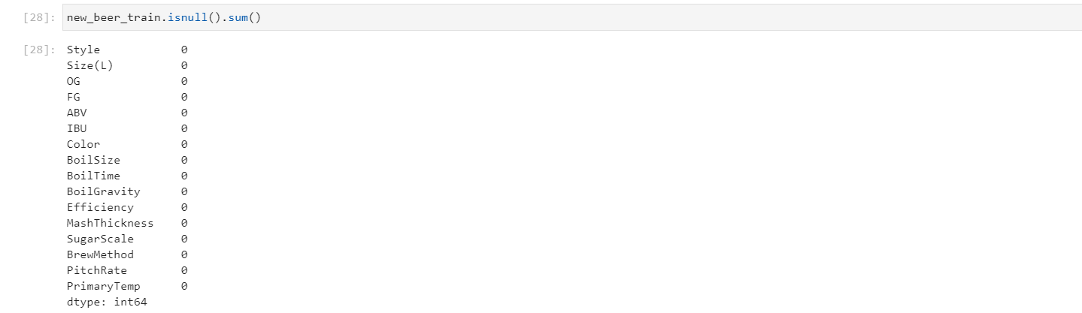
Data Segregation “without” Null Values
Segregated Non Null values to get train data set
This is achieved by using dropna() function

Slide 6
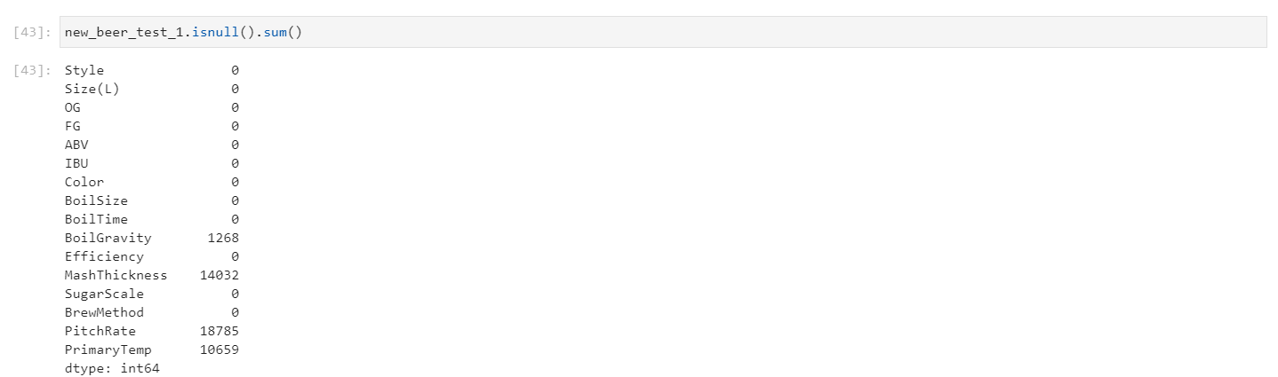
Data Segregation “with” Null Values
Segregated Null values to get test data set
This is achieved by using df2[df2.isnull().any(axis=1) function

Slide 7
Statistical Analysis
Dependent variable is continuous, hence linear regression model is adopted.
Used the following linear models:
Linear Regression using Sklearn tool kit.
OLS Regression using StatsModels.api

Slide 8
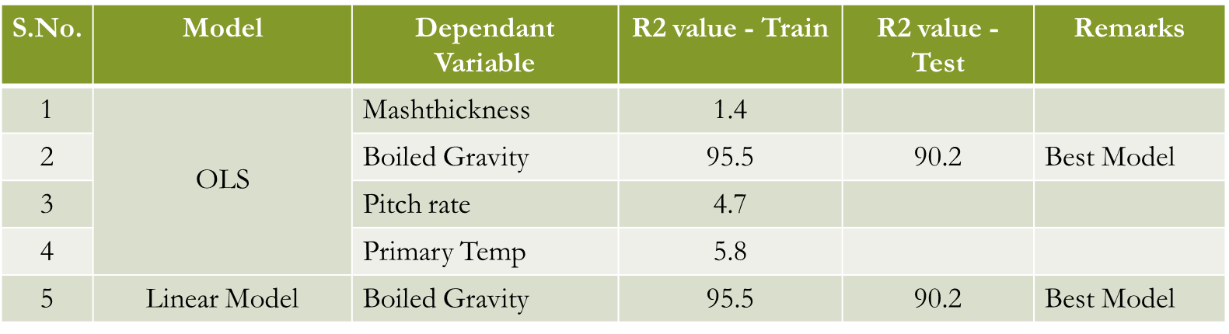
Comparison of Linear Predictive Models

Slide 9
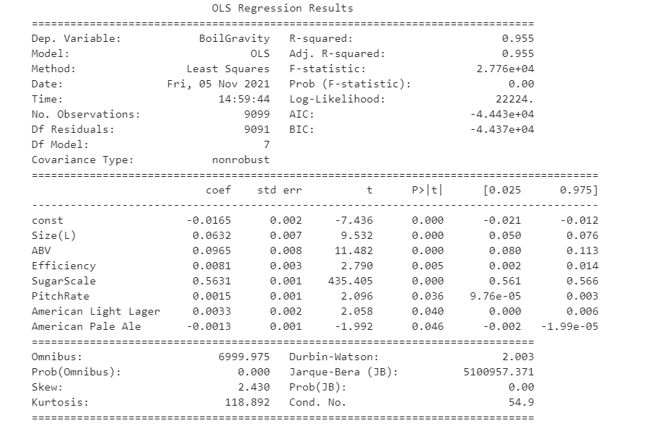

Conclusion and Summary
Model with Boiled Gravity as dependent variable seems the best fit since it has:
High R2 value
High Adj R2 value
High F statistic
Low P value for various independent variables, which makes null hypothesis to be rejected.
When boiled gravity increases sugar concentration increases
https://github.com/subbrisaravanan/Beer-Data-Set

Slide 10
Back up and Supporting Analysis

Slide 11
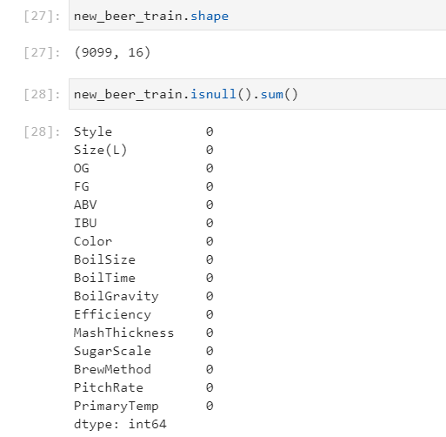
Step 1
Segregate the data which has no missing value from both “new_beer_test” and “beer_train” combine them create a new training set as “new_beer_train”

Slide 12

Step 2
Create another test set with missing values “ new _beer_test_1”

Slide 13
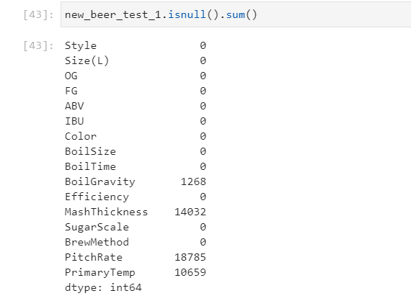
Step 3
Target variables with missing values
MashThickness
BoilGravity
PitchRate
PrimaryTemp

Slide 14
Supporting Pointers
Mash Thickness
Boil Gravity
Means the three gallons of wort you are starting your boil with as a
specific gravity of 1.059.
A thicker mash is more gentle to the enzymes because of the lower heat capacity of grain compared to water.

Slide 15
Supporting Pointers
Pitch Rate
Primary Temperature
Pitching rate or final cell count C2 = number of cells/ml when diluted in final volume of wort to be fermented.
62-75 °F (17-24 °C) Lagers: 46-58 °F (8-14 °C)
Note: Lager fermentations can be started warmer (~60 °F/15.5 °C) until signs of fermentation (gravity drop, CO₂ production, head formation) are evident.

Slide 16
Solution Proposal
Solution adopted here is Ordinary Least Square Linear Regression model

Slide 17
Mathematical Model of OLS
In statistics, ordinary least squares (OLS) is a type of linear least squares method for estimating the unknown parameters in a linear regression model.
OLS chooses the parameters of a linear function of a set of explanatory variables by the principle of least squares: minimizing the sum of the squares of the differences between the observed dependent variable (values of the variable being observed) in the given dataset and those predicted by the linear function of the independent variable.

Slide 18
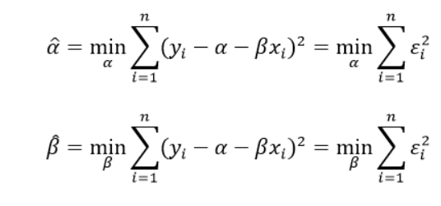
Supporting Pointers
To be more precise, the model will minimize the squared errors: indeed, we do not want our positive errors to be compensated by the negative ones, since they are equally penalizing for our model.

Slide 19

Supporting Pointers
OLS equation looks like this

Slide 20
Multivariate Modelling
As the name implies, multivariate regression is a technique that estimates a single regression model with more than one outcome variable.
When there is more than one predictor variable in a multivariate regression model, the model is a multivariate multiple regression.

Slide 21
Steps Followed
Select Dependent Variable
Import RFE (Recursive Feature Elimination) to select best features.
Based on best Features selected, create an OLS model with summary
Key Summary statistics: R2, adj R2, Probability of independent variables, Variance Inflation Factor

Slide 22
Predictive Modelling
First Imported Data set
Merged Beer Sample submission and beer test and renamed it as new_beer_test
Segregated data set without null value as Train and with null value as test
Performed EDA on dataset

Slide 23
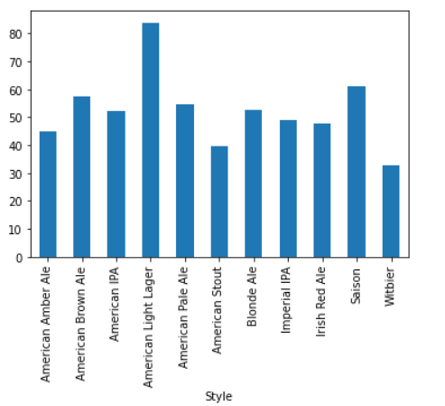
Style vs Size
Beer styles differentiate and categorize beers by color, flavor, strength, ingredients, production method, recipe, history, or origin.
American Light Larger has higher size value

Slide 24
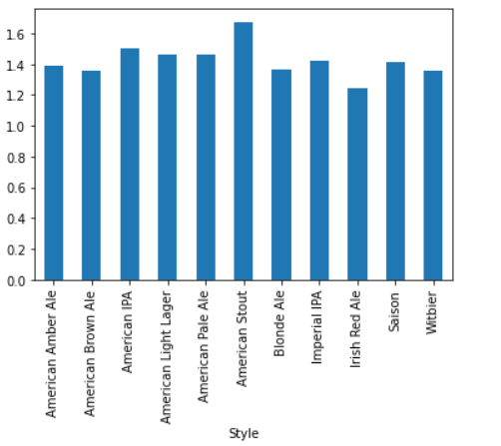
Style vs OG
Original gravity is defined as the relative density of the wort – the liquid that will ferment and become beer.
American stout has higher OG

Slide 25
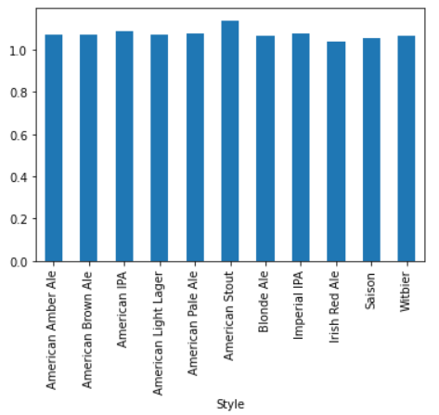
Style vs FG
If the fermentation is finished, the specific gravity is called the final gravity (abbreviated FG)
American stout has higher FG

Slide 26
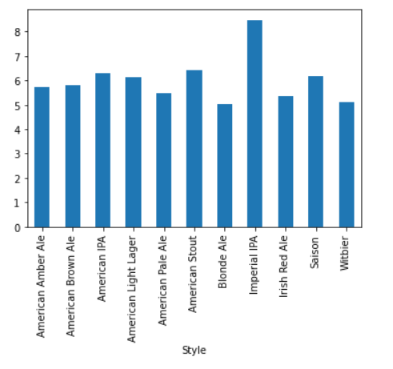
Style vs ABV
Technically, alcohol by volume is defined as a standard measure of how much alcohol is contained in a given volume of an alcoholic beverage. It is defined as the number of milliliters (mL) of pure ethanol present in 100 mL of solution at 20°C (68°F).
Imperical IPA has higher value

Slide 27
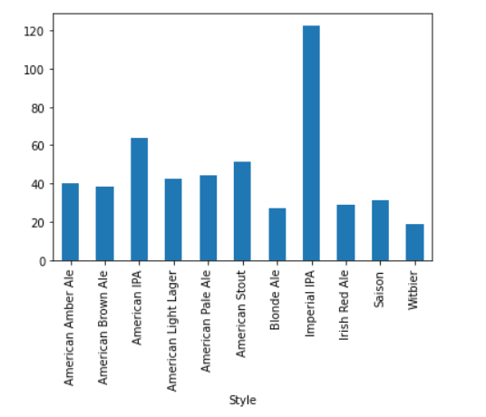
Style vs IBU
IBUs stand for International Bittering Units ‒ a pretty good gauge of a beer’s bitterness.
Imperical IPA has higher value

Slide 28
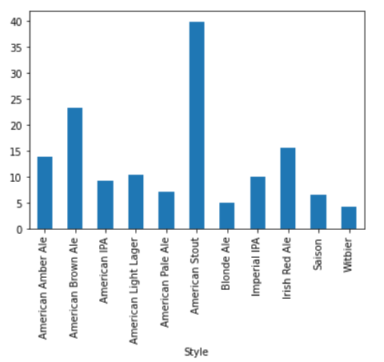
Style vs Color
American Stout has higher value

Slide 29
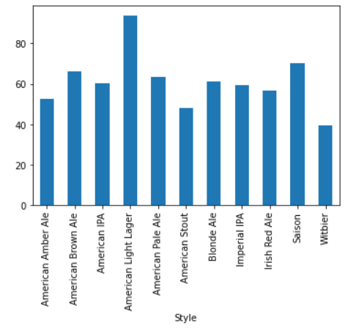
Style vs Boilsize
American Light Larger has higher value

Slide 30
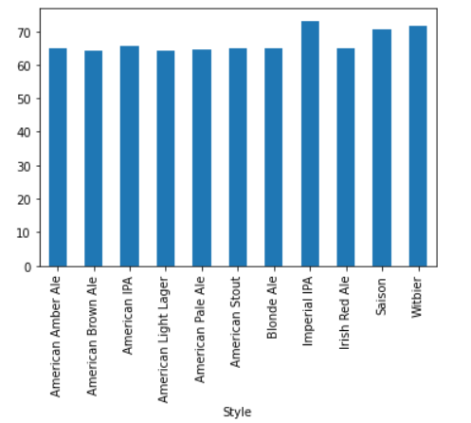
Style vs Boiltime
Imperical IPA has higher value

Slide 31
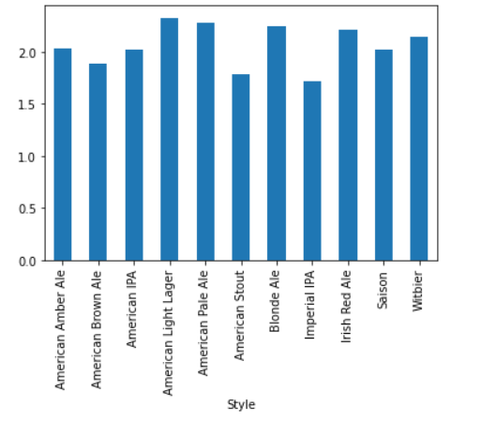
Style vs Mash Thickness
American light larger has higher value

Slide 32
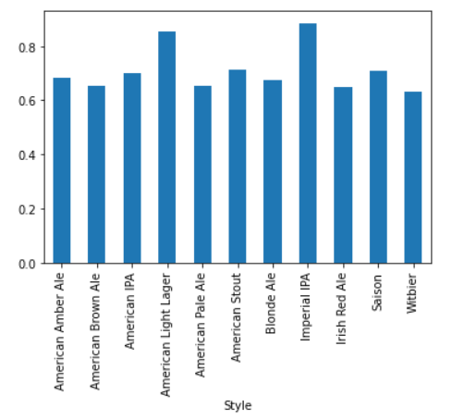
Style vs Pitch Rate
Imperical IPA has higher value

Slide 33
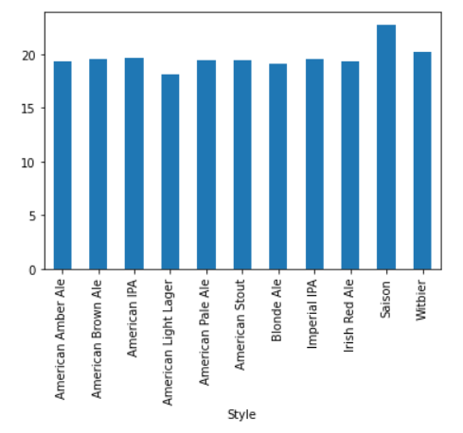
Style vs Primary Temp
Saison has higher value

Slide 34
Challenges Faced in the Dataset
Highly skewed dataset
Most variables are highly skewed
When we apply transformation and build model, kurtosis and skewness is extremely high.
Less emphasis is given to skewness and kurtosis

Slide 35
Applications
Used to find the optimal value of mash thickness to attain original gravity
Used to find the optimal value for maintaining color, gravity, etc.

Slide 36
Thank you

